Slide 1


My presentation
<Atul Prajapati>

Slide 2

<bank telemarketing campaign project>
The bank aims to enhance its revenue by conducting a cost-efficient telemarketing campaign for term deposits among existing customers.
The objective is to conduct an end-to-end Exploratory Data Analysis (EDA) on the campaign dataset, identifying patterns and providing insights to improve the positive response rate.
The analysis will involve examining customer demographics, temporal trends, and other factors influencing the success of the campaign, ultimately offering recommendations for targeted improvements in the bank's marketing strategy.

Slide 3

Software/Tools:
Jupyter Notebook(Python)
Python

Slide 4

Performing eda / Crisp dm :
Conduct a thorough Exploratory Data Analysis (EDA) on the dataset related to the bank's telemarketing campaign.
Business Understanding
Data Understanding
Data Preparation
Modeling
Evaluation
Deployment

Slide 5


Understanding structure of the data
Raw Data
Shape and Size of the data :
45211 rows and 19 column are presented.
float(64) and int(64) and object data type present in this data.
There are 4 column where the some of the data is missing :– age=20, month=50, response=30 and date=50 rows data are missing.

Slide 6

Task to Perform :
1. Understanding the Dataset
Before performing EDA on this dataset we have to import some tools like, Pandas, Numpy, Matplotlib, Seaborn and Datetime etc.
Loading the dataset : Function is used [pd.read_csv( )], if the dataset is in CSV format.
Review the structure using function [df.head( )], for the first 5 rows to display.
Checking the Column name and Data type using the [df.info( )] method to get information on the dataset.
Outliers and Inconsistencies of the data: Using [df.describe( )] to spot the outliers in numerical column and Checking for any formatting issues, incorrect data types, or values that don't align with the expected patterns.

Slide 7
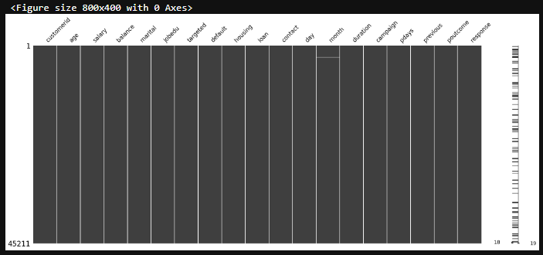
Missing Value: Using function [df.isnull( ).sum( )] or [df.isna( ).sum( )] to identify missing values.
For identifying the missing value.
Total missing value present in column age, month, response and date.

Slide 8
Analyzing the distribution of responses to the term deposit campaign helps determine whether the data is balanced or imbalanced.
Analyze skewness of the data.
Analyze any spread / anomalies in the data set.
Splitting / Combine variable ( .split() ) / (.concat() ).
Outliers present in specific column:
age : 487 salary : 0 balance : 4729 campaign : 3064 pdays : 8257 previous : 8257

Slide 9
2. Descriptive Statistics :
We have to analysis summary statistics mean, mode, median and std. deviation of relevant columns reveal key insights about the data.
variables | count | mean | std | min | 25% | 50% | 75% | max
age | 45211.0 | 40.934795 | 10.616926 | 18.0 | 33.0 | 39.0 | 48.0 | 95.0
salary | 45211.0 | 57006.171065 | 32085.718415 | 0.0 | 20000.0 | 60000.0 | 70000.0 | 120000.0
balance | 45211.0 | 1362.272058 | 3044.765829 | -8019.0 | 72.0 | 448.0 | 1428.0 | 102127.0
campaign | 45211.0 | 2.763841 | 3.098021 | 1.0 | 1.0 | 2.0 | 3.0 | 63.0
pdays | 45211.0 | 40.197828 | 100.128746 | -1.0 | -1.0 | -1.0 | -1.0 | 871.0
previous | 45211.0 | 0.580323 | 2.303441 | 0.0 | 0.0 | 0.0 | 0.0 | 275.0

Slide 10
Calculating Median of numeric variables :
Age : 39.0
Salary : 60000.0
Balance : 448.0
Campaign : 2.0
pdays : -1.0
Previous : 0.0
Skewness of the numeric variables:
Age : 0.685377
Salary : 0.137829
Balance : 8.360308
Campaign : 4.898650
pdays : 2.615715
Previous : 41.846454
Standard deviation for the numeric variables :
age : 10.616926
salary : 32085.718415
balance : 3044.765829
campaign : 3.098021
pdays : 100.128746
previous : 2.303441

Slide 11
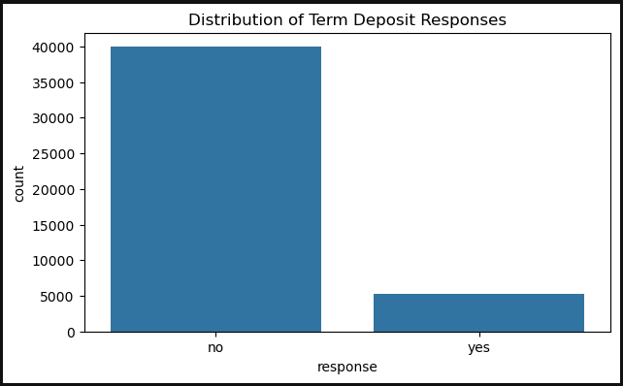
Visualize the Distribution of the target variable using bar chart.
Response : Term deposit campaign is successful or In this,
We have the the total count of YES or NO
No( response) >= Yes(response)
Response: no : 39924 yes : 5287

Slide 12
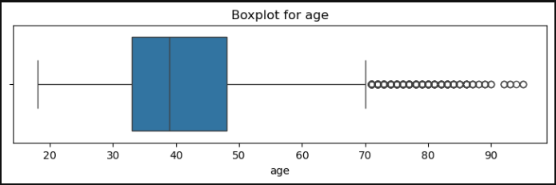
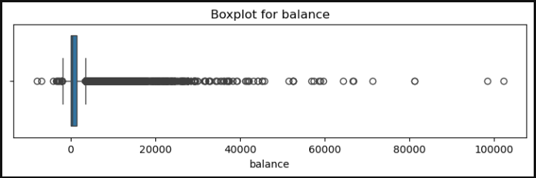
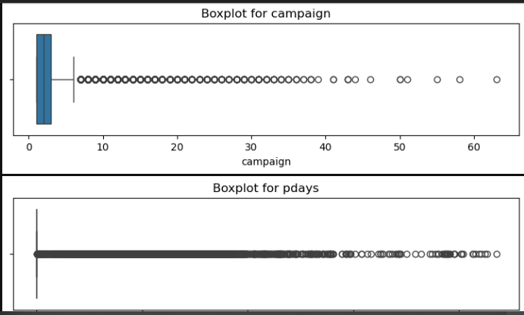
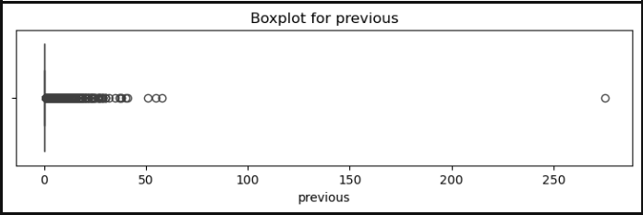
Examining the distribution of individual key features.
Detecting outliers using box plot.
Checking the skewness of the data.
For doing It, one more chart has been done for identifying outliers. "kdeplot".

Slide 13
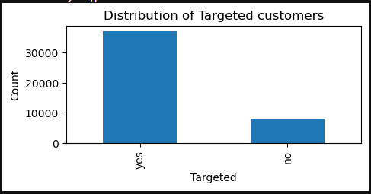
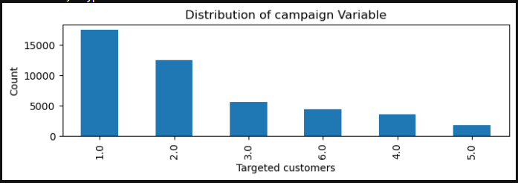
Particular customer before targeted or not showing through the bar plot
Targeted : yes : 37091 no : 8120
Count the numbers of Campaigned customers: 1.0 : 17544 2.0 : 12505 3.0 : 5521 6.0 : 4355 4.0 : 3522 5.0 : 1764

Slide 14
3. Univariate Analysis:
This analysis for individual key features such as age, balance and call duration.
Examining distribution of these features:
Distribution of Age : count : 45211 mean : 40.934795 std : 10.616926 min : 18.000000 25% : 33.000000 50% : 39.000000 75% : 48.000000 max : 95.000000
Distribution of balance:
count : 45211.000000 mean : 1362.272058 std : 3044.765829 min : -8019.000000 25% : 72.000000 50% : 448.000000 75% : 1428.000000 max : 102127.000000
Distribution of call duration : count : 45211.000000 mean : 258.163080 std : 257.527812 min : 0.000000 25% : 103.000000 50% : 180.000000 75% : 319.000000 max : 4918.000000

Slide 15
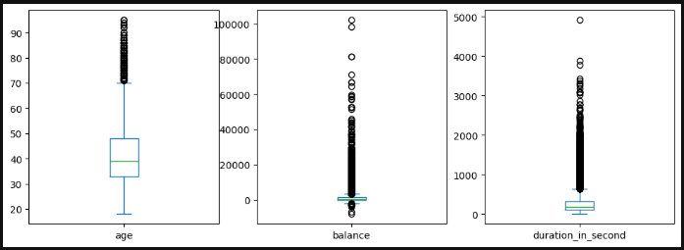
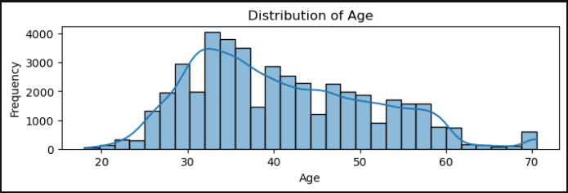
Visuals aids of Box Plot:
Reveal outliers and variability across the data.
Histogram show us the skewness or normality of the distribution.

Slide 16
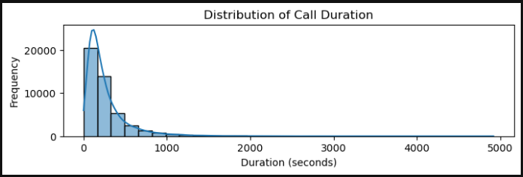
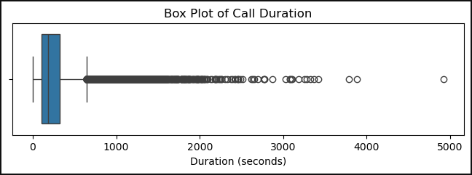
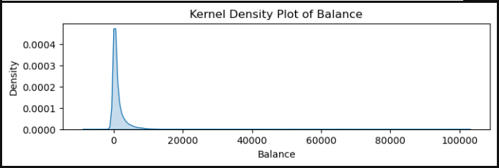
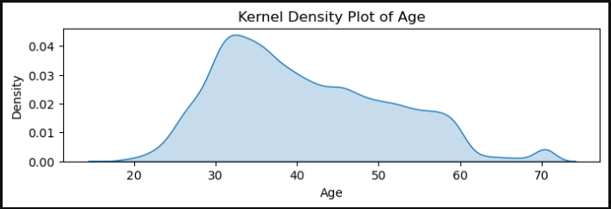
Kde_plot give us the clearer view of the distribution's shape, revealing multiple peaks or spread.

Slide 17
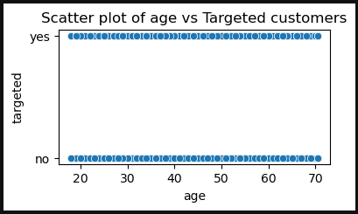
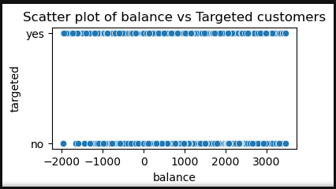
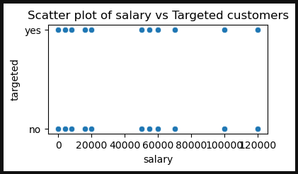
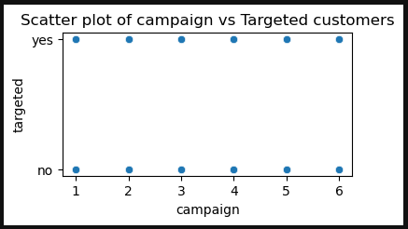
4. Bivariate Analysis :
For numerical variables, we can use correlation and visualizations like scatter plots or box plots.
Correlation with customers who has been targeted :
age : 0.115035
salary : -0.222868
balance : -0.047823
day : -0.012891
month : 0.031924
Campaign : 0.007882

Slide 18
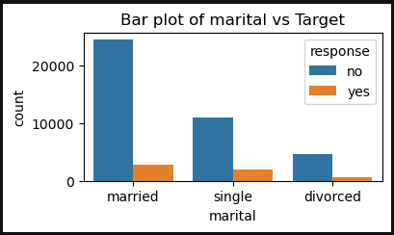
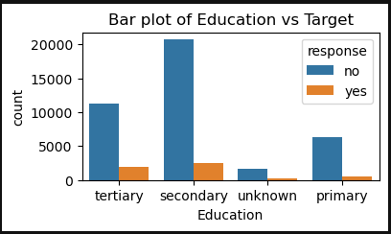
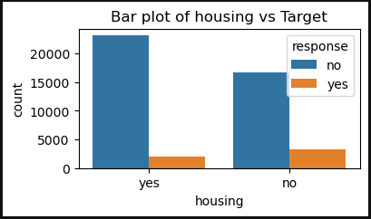
For categorical variables, we can use crosstabs and visualizations like bar plots or count plots.
Crosstab for marital: response no yes marital divorced 4585 622 married 24460 2754 single 10879 1911
Crosstab for Education: response no yes Education primary 6260 591 secondary 20753 2449 tertiary 11306 1995 unknown 1605 252
Crosstab for housing: response no yes housing no 16728 3353 yes 23196 1934

Slide 19
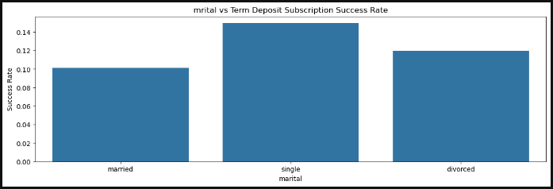
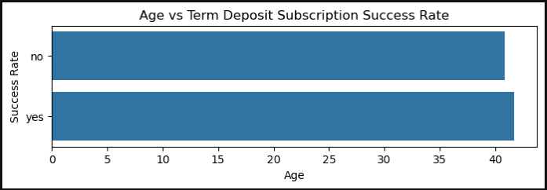
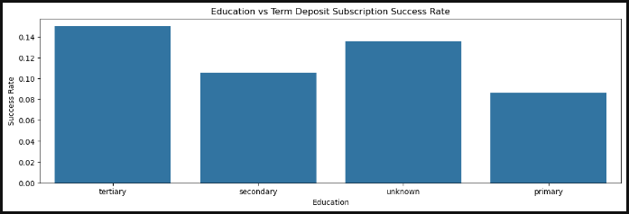
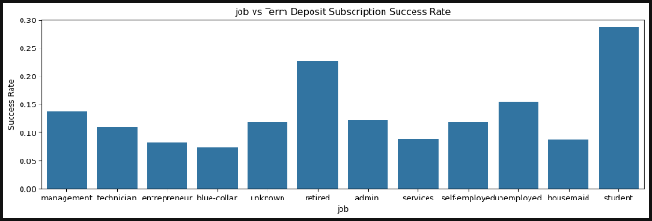
Bar charts: Compare the distribution of each categorical feature (like job type, education) with the success rate of the campaign.
It show which categories of a feature are more likely to lead to successful outcomes.

Slide 20
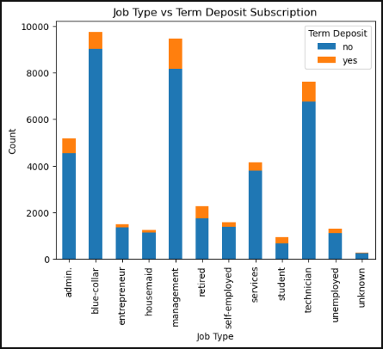
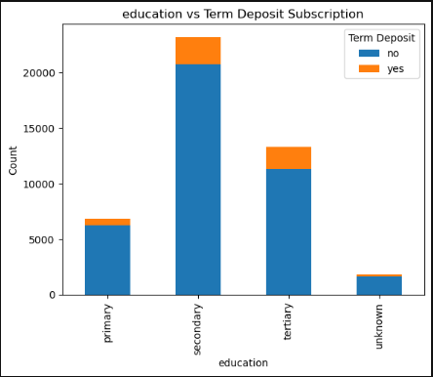
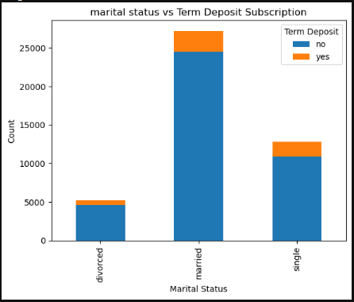
Stacked bar charts: Show the proportions of success and failure across different categories within features, highlighting patterns.
It reveal variations in success rates within each category.

Slide 21
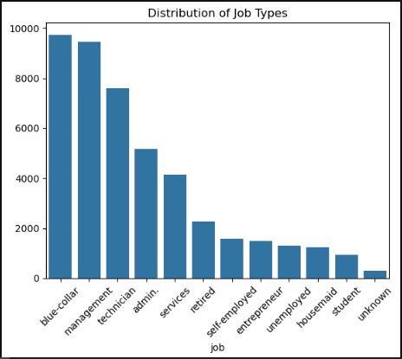
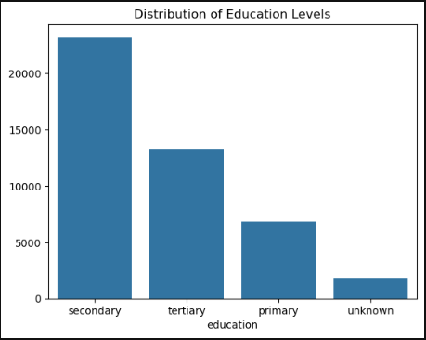
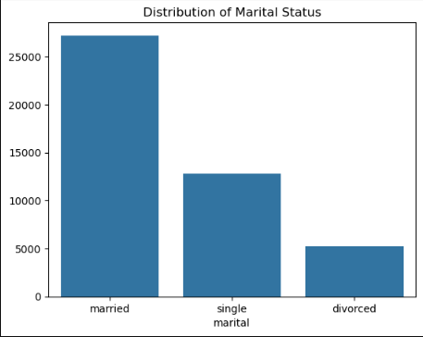
5. Categorical Variables Analysis
Analyze the frequency distribution of categorical variables like job type, education, and marital status using bar chart frequency tables.
Analysis of top 3 subcategories.
Distribution of Education variable : education secondary 23202 tertiary 13301 primary 6851
Distribution of Marital status variable : marital married 27214 single 12790 divorced 5207
Distribution of Job variable : job blue-collar 9732 management 9458 technician 7597

Slide 22
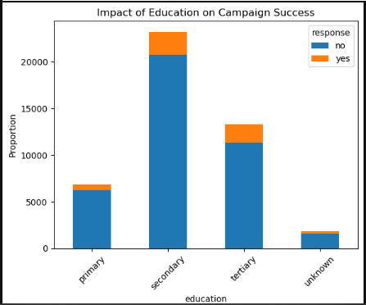

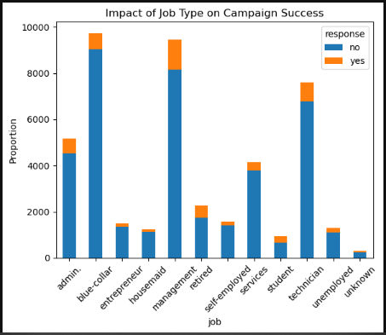
This charts will show how different categories (e.g., job types or education levels or marital status) influence the success rate.
Is there campaign is success or not? Describe through the charts.

Slide 23
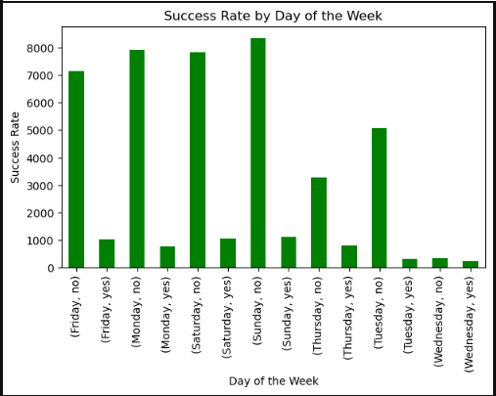
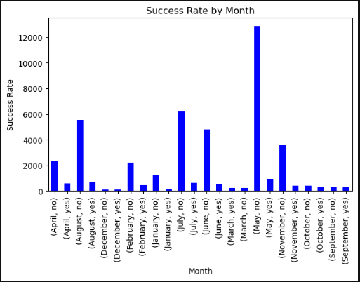
6. Temporal Analysis
Identify trends in campaign success over time to understand seasonal variations or external factors affecting performance.

Slide 24
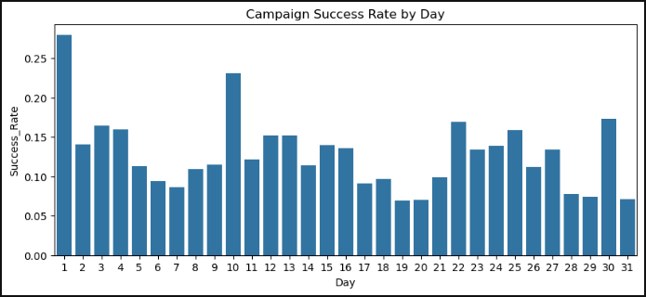
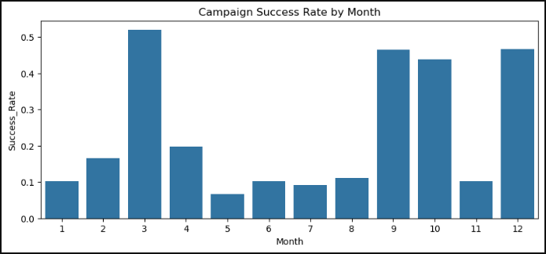
Analyze specific months and days for higher success rates, revealing customer availability or seasonal influences on campaign outcomes.
If success rate more than 0.8 then campaign is successful.

Slide 25
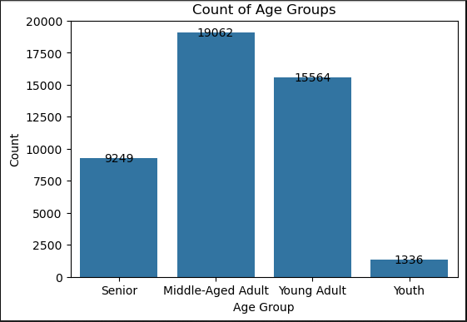
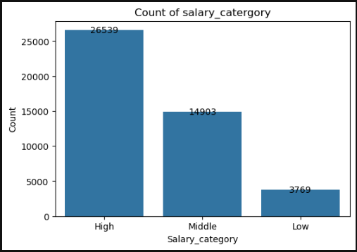
7. Feature Engineering :
This involves creating additional variables that can improve model performance.
Here, Age and Salary data have been grouped into categories.

Slide 26
If the data contains categorical variables we need to convert them into numerical form.
This can be done using encoding techniques like "label encoding", "one-hot encoding", "binary encoding".
Before encoding the variables we have to import a function " from sklearn.preprocessing import LabelEncoder ".
Applying Binary Encoding to high-cardinality categorical variables on ( "job", "education").
Job have 4 category
Education have 3 category
Applying One-Hot Encoding to low-cardinality categorical variables on [marital, contact and poutcome].
For subcategory encoding with (true / false) data.
Apply Label Encoding to ordered categorical variables like 'month' and 'day_of_week'.
Here, In month and day_of_week columns count as a number used in another variables.

Slide 27
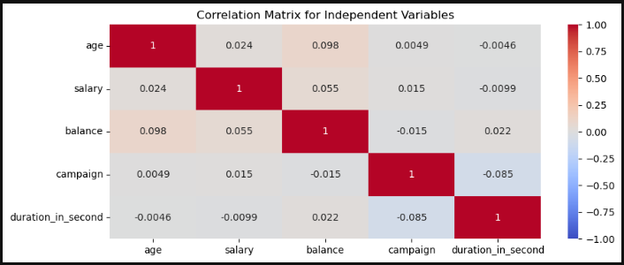
8. Correlation Analysis :
If values closer to 1 or -1 indicate high correlation, suggesting potential multicollinearity.
If independent variables show high correlation (e.g., > 0.8), it indicates multicollinearity, which can negatively impact the model by making coefficient estimates unstable.

Slide 28
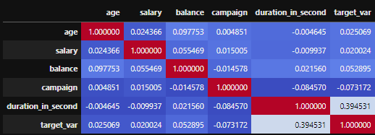
The correlation of features with the target variable.
target_var : 1.000000 duration_in_second : 0.394531 balance : 0.052895 age : 0.025069 salary : 0.020024 campaign : -0.073172
Correlation parameters:
Value >= 0.8 : Highly correlated
which can negatively impact the model by making coefficient estimates unstable.
There are no any variable which have highly correlated pairs.
Analyzing heatmap for the correlation.

Slide 29
Highly correlated features parameters:
Once we have the correlation values, we can filter out features that have a strong correlation with the target variable.
For example,
we might want to focus on correlations greater than 0.5 (strong positive correlation) or less than -0.5 (strong negative correlation).
Features with higher correlation values with the target are more likely to be important predictors.
There are no any integer variable(features) to identifying the relationship with the target_var.

Slide 30
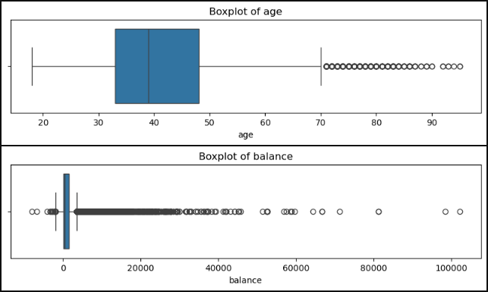
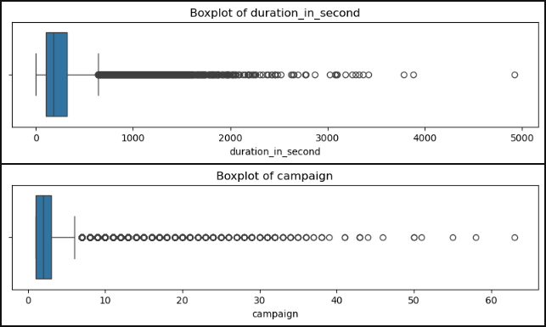
9. Outlier Detection and Handling :
Identifying outliers: Using statistical methods like the IQR (Interquartile Range), or visualization tools like boxplots to spot outliers.

Slide 31
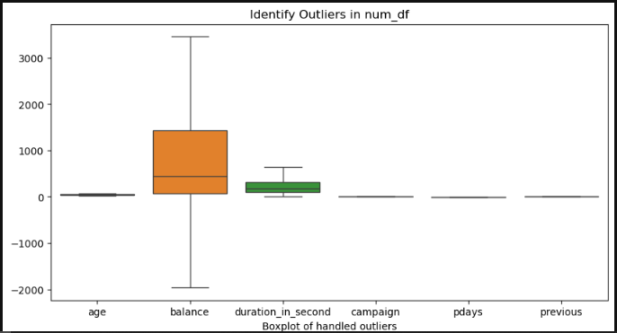
Capping method / Flooring method
These method use to handle the outliers.
Limit extreme values to a certain range.
Charts after handling outliers.
Imputing or replacing them with mean, median, or other suitable values.

Slide 32
Based on the analysis, proposing areas where the bank can enhance its positive response rate. :
Focus on customers aged 18-25, as this group is more likely to subscribe.
Married individuals tend to respond better than single customers.
Target campaigns between May, July, June and August, as response rates are higher during this period.
Focus on mid-week (Tuesday, Saturday, Sunday and Friday ) for better engagement.
Communication strategies :
Tailor calls and offers based on customer data, addressing them by name to create a personal connection.
Reach customers at peak times (afternoon) and use follow-up calls or SMS reminders to boost engagement.
Complement phone calls with email and SMS for better reach and reinforcement of the message.
Response of term deposit campaign is not success.
Needs to be improvisation in communication with the customers.
Needs to be Improve with contact category like “ Emails, Social media, SMS etc. ”

